Slide 1

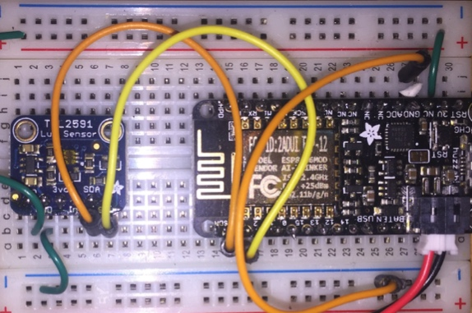
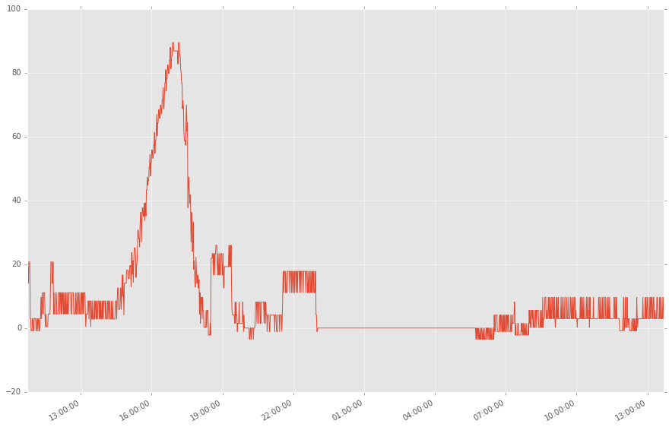
MicroPython IoT Hackathon
Featuring the ESP8266
Jeff Fischer
Data-Ken Research
jeff@data-ken.org
https://data-ken.org
Sunnyvale, California, USA
January 2017

Slide 2
Tonight’s Agenda
Overview lecture
Build and test system (hardware and software)
Additional projects (if time permits)

Slide 3
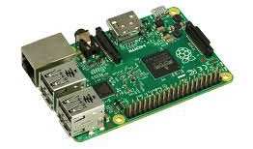
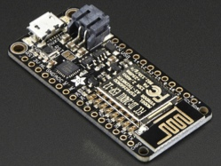




Why Python for IoT?
High-level, easy to prototype ideas and explore options
Runs on embedded devices
Python data analysis ecosystem
Array and matrix processing
High level data analysis tools
Numerical analysis routines
HMMLearn
Machine learning

Slide 4
Basic Electronics
Current
Voltage = Electrical Pressure
Current = Flow of electric charge
Resistance = Difficulty to pass
electric charge
Electrons
+ (Vcc)
Circuit
Power
Supply
Ohm’s Law
V = I R
- (GND)
resistance
voltage
current

Slide 5
Digital Logic
Voltage
Vcc (5V or 3.3V)
High (“1”)
Noise Margin
Low (“0”)
GND (0V)

Slide 6
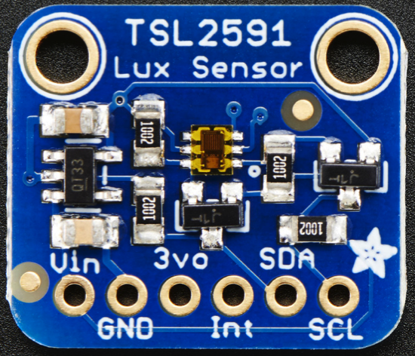
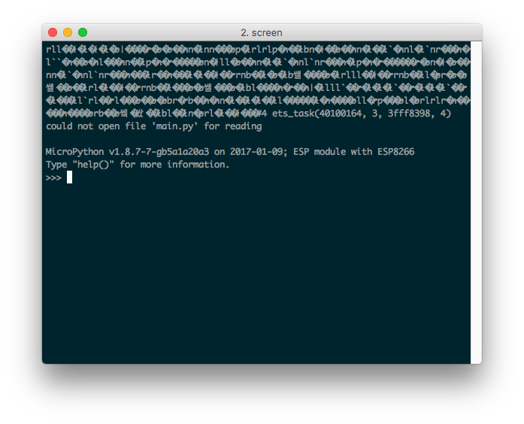
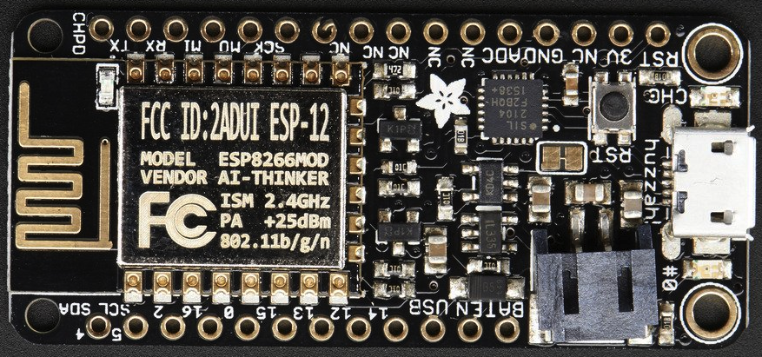
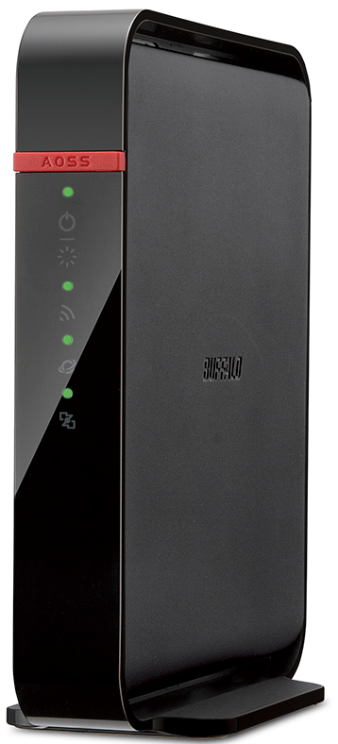
System Overview
TSL2591 Lux Sensor
breakout board
PC/Laptop
USB Cable
MQTT
Broker
I2C Bus
Terminal
session
ESP8266 breakout board
MQTT over WiFi
WiFi Access Point
and Router

Slide 7
Steps
Hardware Assembly
Firmware and software install
Application to read the sensor
Messaging with MQTT

Slide 8
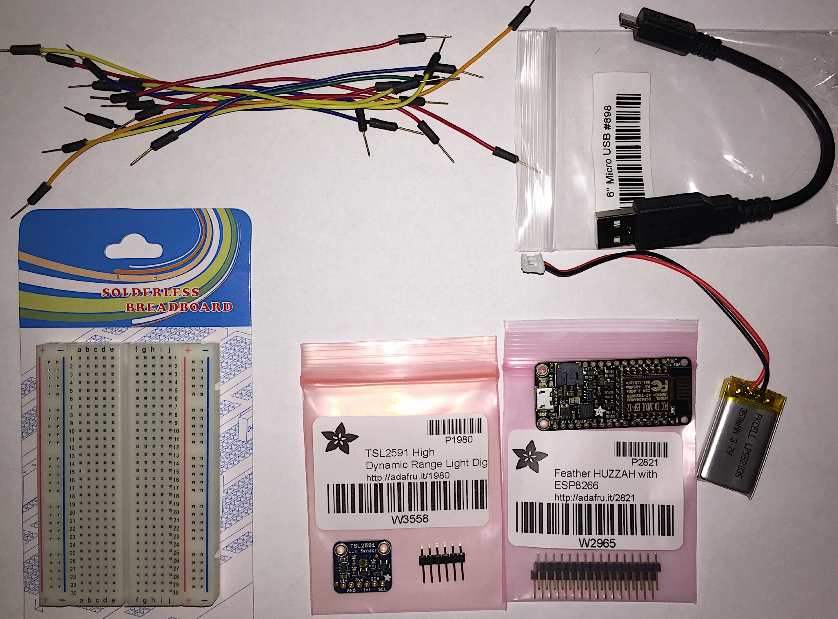
Parts
Wires
USB Cable
ESP8266
Breakout
TSL2591
Breakout
Battery
Breadboard

Slide 9
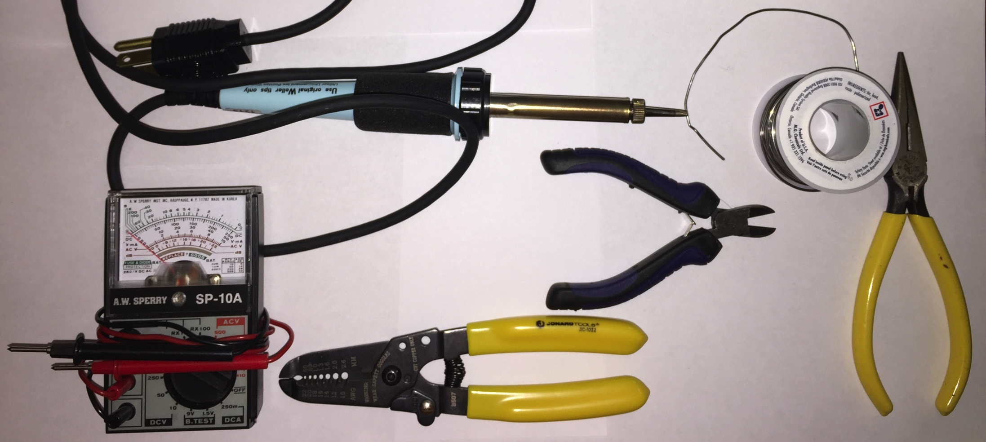
Recommended Tools
Soldering Iron
Solder
Multimeter
Wire Cutters
Wire Strippers
Needle-nose
Pliers

Slide 10
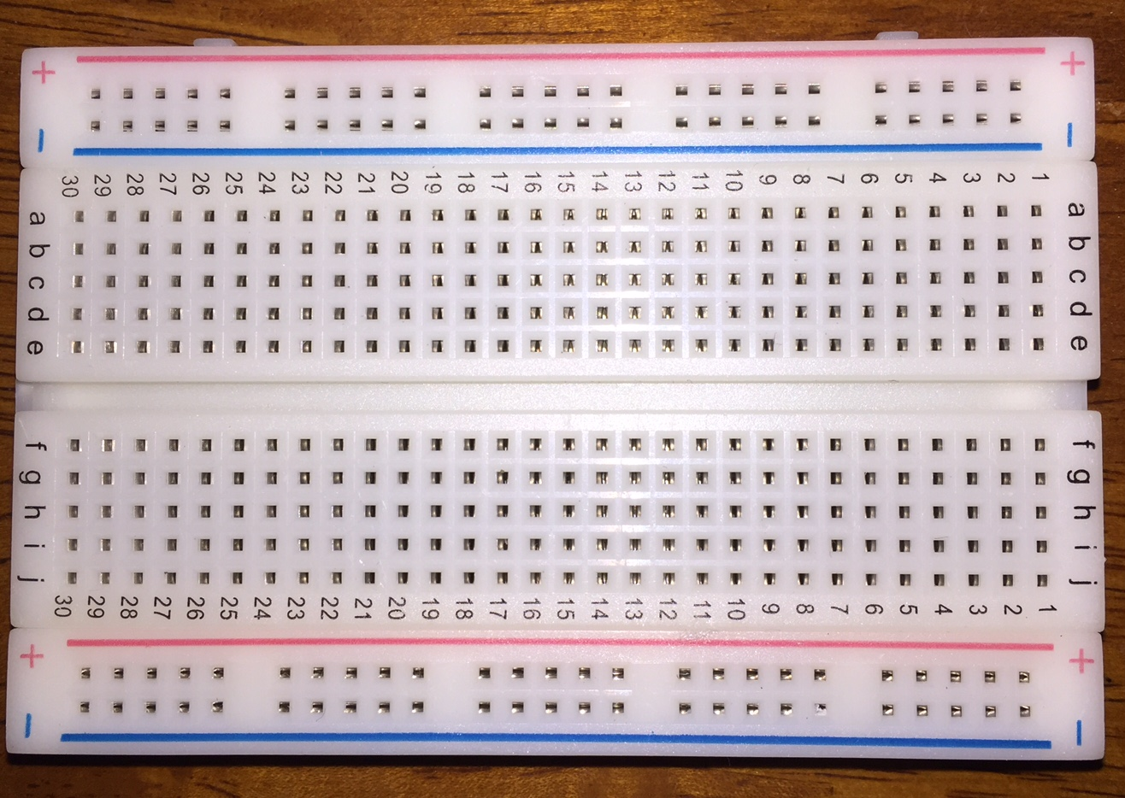
Breadboards
Use for Power
Photo
Electrical Connections
30
29
2
1
a
b
c
d
e
. . .
Board
f
g
h
i
j
Use for pin connections
Use for GND

Slide 11
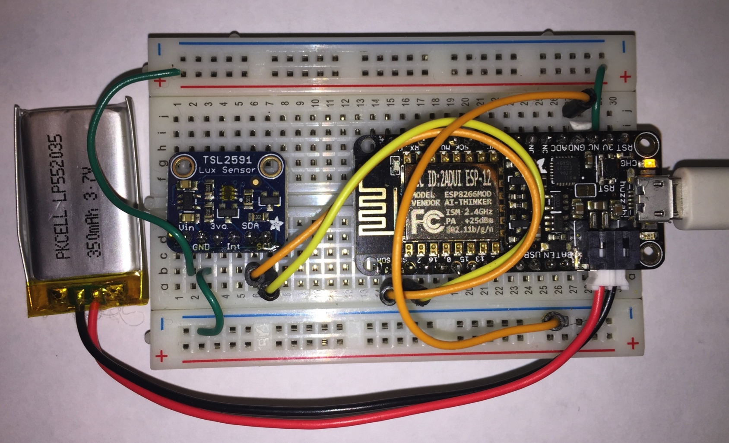
System with Adafruit Feather HUZZAH
½ Size breadboard
Lithium Ion
Polymer
Battery
3.7v 350mAh
MicroUSB to
USB cable
Adafruit Feather HUZZAH
ESP8266 breakout board
TSL2591
lux sensor
breakout
board
Notes:
8266:
32-bit RISC CPU: Tensilica Xtensa LX106 running at 80 MHz
64 KiB of instruction RAM, 96 KiB of data RAM
Power: 15 mA if modem off, 50 – 170 mA when transmitting (http://bbs.espressif.com/viewtopic.php?t=133)

Slide 12
Feather HUZZAH: Wiring Diagram
3V Bus
GND Bus
A3
A1
A2
A5
A4
A6
SDA
SCL

Slide 13
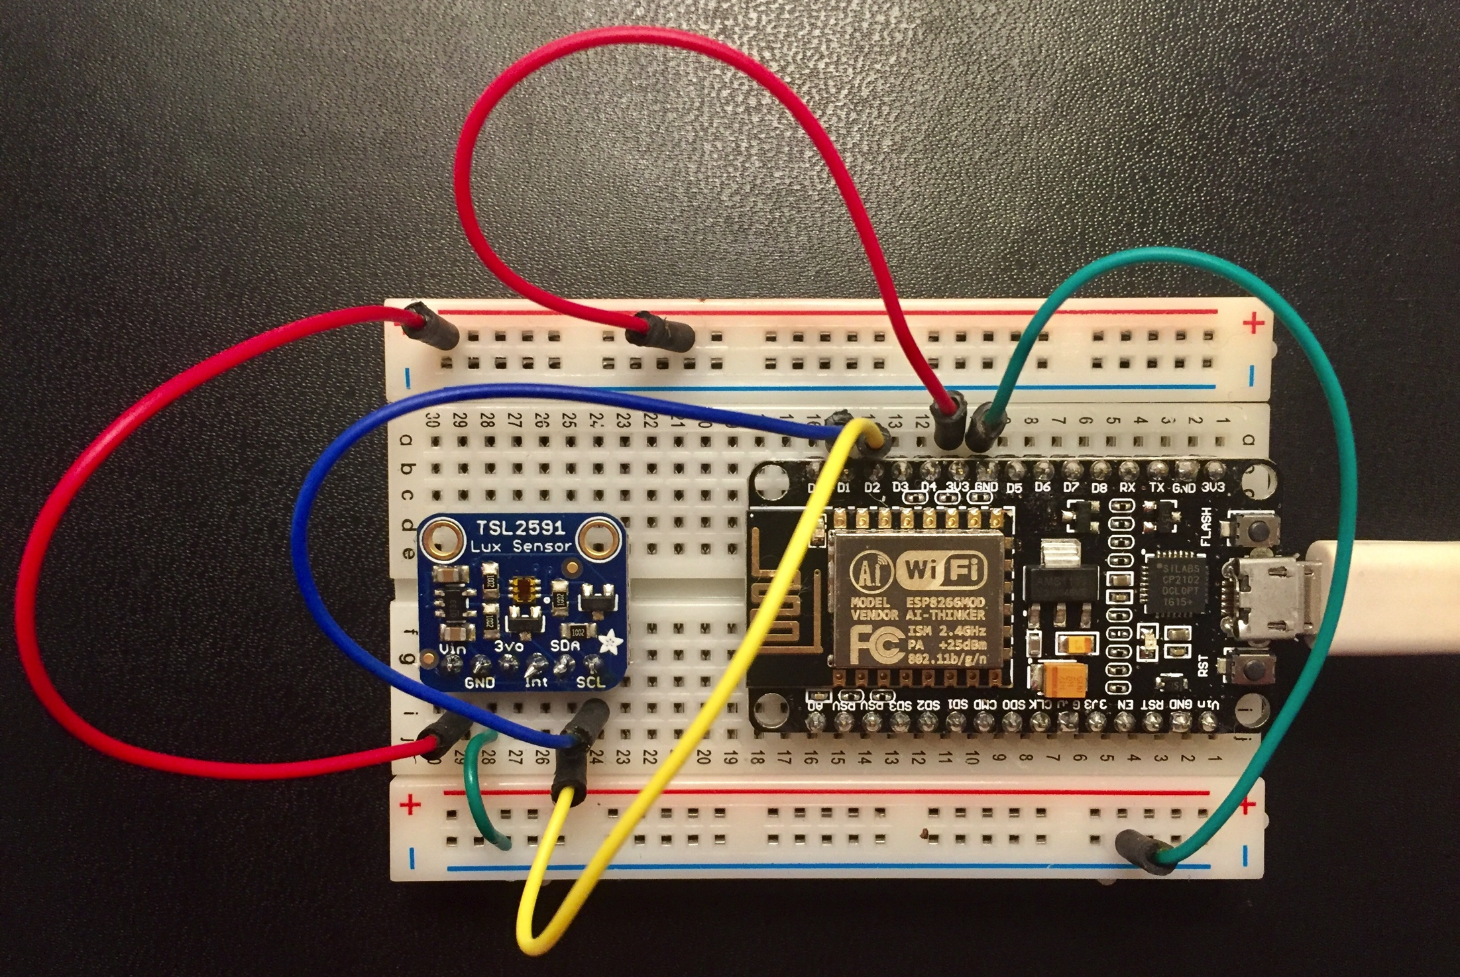
System with NodeMCU
NodeMCU
ESP8266
breakout board
MicroUSB to
USB cable
TSL2591
lux sensor
breakout
board

Slide 14
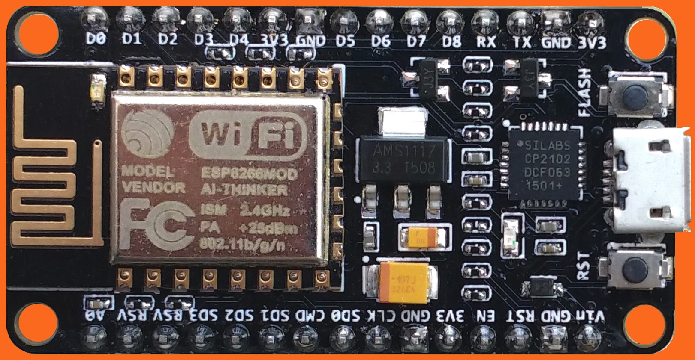
NodeMCU: Wiring Diagram
3V Bus
N3
N5
N1
SDA
SCL
N6
N4
N2
GND Bus

Slide 15
MQTT
Client-A
Publish
Broker
Subscribe
Client-D
Client-B
Publish
Topic1
Subscribe
Client-E
Publish
Topic2
Subscribe
Client-C
Topic3
Client-F
. . .
Subscribe
Publish

Slide 16
Server.py
MQTT
Adapter
Map
to
UTF8
Parse
JSON
Overwrite
timestamp
Write to
CSV
file
mqtt.select(lambda m:(m.payload).decode('utf-8'))\
.from_json(constructor=SensorEvent)\
.select(lambda evt: SensorEvent(sensor_id=evt.sensor_id,
ts=time.time(),
val=evt.val))\
.csv_writer(filename)

Slide 17
Thank You
Questions?
More information
Email: jeff@data-ken.org
Hackathon Tutorial: https://readthedocs.org/search/?q=micropython-iot-hackathon
Website and blog: https://data-ken.org
AntEvents: https://github.com/mpi-sws-rse/antevents-python

